Slide 1
UI Modernization
Plain Language Foundations Workshop (11/23)
U.S. Department of Labor
Office of the Secretary
Office of Unemployment Insurance Modernization

Slide 2
What we’ll be covering
Introduction
What is plain language?
Plain language guidelines
Defining your audience
Information hierarchy
Tactics for writing in plain language
Validating your work

Slide 3
INTRODUCTION

Slide 4
What is PLAIN LANGUAGE?

Slide 5
Plain language, defined
Plain Writing Act of 2010: “Writing that is clear, concise, well-organized, and follows other best practices appropriate to the subject or field and intended audience.”
Content is in plain language if your audience can:
Find what they need
Understand what they find the first time they read or hear it
Use what they find to meet their needs

Slide 6
The importance of audience
You’ll notice that both of the definitions of plain language reference your audience. One thing to note is that there’s no one-size-fits-all audience – we’ll discuss this in more depth later, but it’s a good topic to start thinking about now.

Slide 7
Relevant legislation
Plain language isn’t just nice to have – it’s the law. The following define plain language and related regulations:
The Plain Writing Act of 2010
E.O. 12866
E.O. 12988
E.O. 13563

Slide 8
Benefits of using plain language
Clearer, more actionable content: Help claimants reach their goals more quickly and reduce customer service burden.
Better customer experience (CX): Build stronger, more positive relationships with claimants by providing a better user experience.
Increased equity: Make your content accessible to the broadest possible audience and improve translation quality.
Improved agency reputation: Reinforce your agency’s trustworthiness and transparency.
Compliance with the law

Slide 9
PLAIN LANGUAGE GUIDELINES

Slide 10
Plain language guidelines
Write for your audience
Organize the information
Choose your words carefully
Be concise

Slide 11
Plain language guidelines, continued
Keep it conversational
Design for reading
Follow web standards
Test your assumptions

Slide 12
DEFINING YOUR AUDIENCE

Slide 13
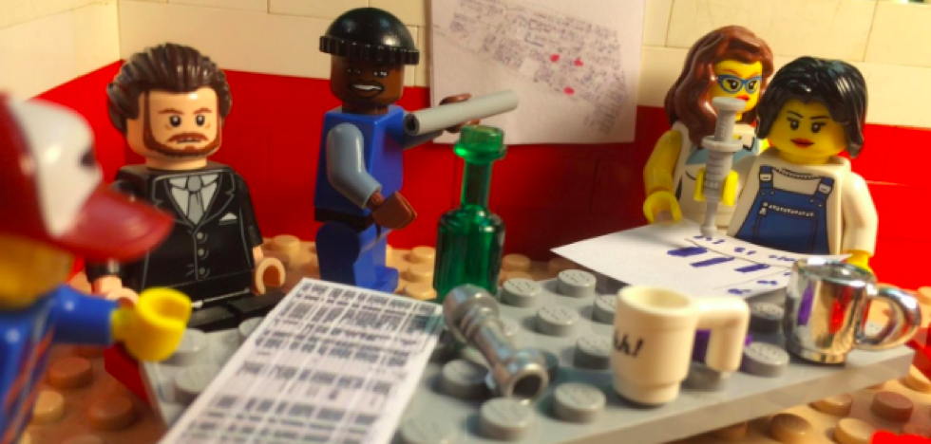
The importance of knowing your audience
We know it’s important to understand our core users, but why is it important?

Slide 14
The importance of knowing your audience
To create user-centered content, we need to deeply understand our users.
More than just demographic info and interactions with product – need to understand goals, fears, motivations, challenges.
Deep understanding fosters deeper empathy, which translates to better content strategy.
Understanding our users’ goals, desires, and motivations helps us make informed decisions about how to create, organize, and present content.

Slide 15
Audience needs & design implications
Who your users are, along with their expectations for your product or service, shape all aspects of your content. Consider how a claimant’s needs might impact the following:
Tone: What tone might resonate best with a new or returning UI claimant? (Trauma-informed design)
Word choice: How to address the user? How much jargon or legalese to use?
Brevity: What volume of content might your readers be comfortable encountering?
Information hierarchy: What information are claimants seeking first? What’s less important?
Contextual help: What information might need clarification, and how might users expect to find contextual definitions or other hints?
Design for various devices: How will most of your users be accessing your content (web vs mobile)?

Slide 16
Complex audiences
Knowing our audience’s needs might be straightforward if we’re designing for a small or fairly targeted group of individuals, but what if we’re designing for large, very diverse user groups?

Slide 17
Complex audiences – approaches
Review organizational goals
Consider how your target audiences are prioritized
Create content user stories to identify core tasks
Validate your approach using research
Creating user stories
As a [user type],
I want to [task to be completed]
so that I can [goal to be achieved].
Sample user story
As a first-time UI claimant,
I want to understand all application requirements
so I can correctly complete my application the first time, increasing my likelihood of gaining access to the benefits I’m eligible for.

Slide 18
Exercise: audience traits
Now that we’ve talked a bit more about audience, let’s take a few minutes to complete an audience-definition exercise.
First, write down a word or phrase that defines the core essence of your audience.
Next, list as many characteristics as you can about your core audience.
Finally, list any constraints that may be specific to your audience (e.g., they only use mobile devices, they have internet access at work but not at home, they have lower trust in the government than average, etc.)
Once everyone is done brainstorming, we’ll share what we wrote.

Slide 19
INFORMATION HIERARCHY

Slide 20
Information hierarchy, defined
Before we cover information hierarchy best practices, it’s important for us to share a common definition of the term.
Information hierarchy is how information is arranged (within a paragraph, within an article, or on a webpage) so that it makes sense to the user. Good information hierarchy allows a user to understand what’s being communicated and to take action on that content.

Slide 21
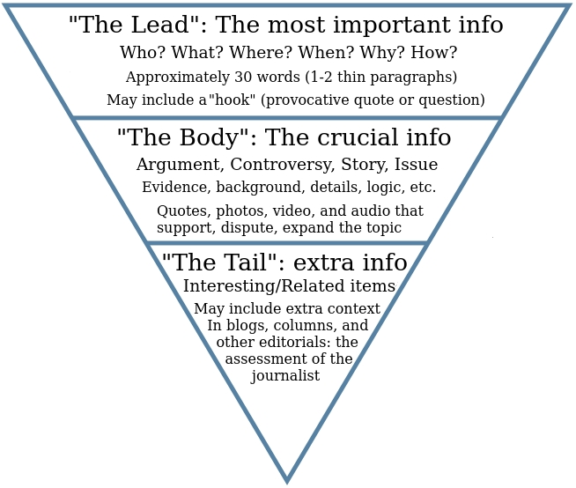
Information hierarchy approaches
When we’re designing content that describes processes, chronological order is often best. What does the reader need to do first, second, third, and so on?
We can also keep the inverted pyramid structure in mind, especially for content that isn’t as process focused. Present the most important information first and follow it with supporting information.

Slide 22
Headings
Headings give users a map of the content they’re about to encounter – they help a user form expectations about what they will (and won’t) find on a page.
In this context, heading refers both to the page heading (what many people think of as the page title – it’s an H1) and section headings (which distinguish different sections of content on a given page).
Be descriptive
Be concise
Use proper heading structure to promote accessibility

Slide 23
Writing strong paragraphs
Just as longer pieces of content should follow the inverted pyramid structure, paragraphs within that content should follow a logical structure. Follow these tips to write stronger paragraphs:
Begin with a topic sentence: This helps your readers set expectations around what to find in the paragraph.
Include keywords at the top: If you’re using keywords, try to add them to the first or second sentence.
Be concise: Try to keep your paragraph no longer than 5 sentences (3-5 sentences is recommended). A single sentence can be its own paragraph.
Consider white space: Chunking information helps readers process it more easily – make sure you’re including adequate white space between paragraphs.

Slide 24
WRITING IN PLAIN LANGUAGE

Slide 25
Address the reader as “you”
Your agency may already be addressing your readers as “you” (and if that’s the case, that’s great!). Many government agencies and private-sector organizations follow this convention.
There are a few reasons we recommend addressing the user as “you,” whenever possible:
It’s friendlier: From a customer-experience standpoint, it’s somewhat awkward to refer to your users in the third person; reading about oneself in the third person can also be a bit jarring. Your readers are going through an emotionally taxing experience – make your content as friendly and welcoming as possible to create a better experience.
It’s more direct: As the 18F content guide notes, government sites often implore their users to take action, and UI sites are no different. When you refer to your users as “you,” you make it clear what actions they should – and shouldn’t – take.

Slide 26
Use active voice
Active voice – the grammatical voice in which the subject of a sentence performs the verb – is the most common voice used, as well as the most engaging.
We recommend using active voice for several reasons:
It’s the easiest voice for readers to understand.
It’s more engaging than passive voice.
It promotes conciseness (sentences written in active voice tend to be shorter than those written in passive voice).
It clearly communicates who (subject) does what (verb).

Slide 27
Examples: active and passive voice
Examples of active voice:
You must include your Social Security number on your initial claim – we use this information to verify your identity.
You’re responsible for checking the accuracy of wage and earnings information.
If you have questions, contact us.
Examples of passive voice:
Your initial claim application must include your Social Security number to allow us to verify your identity.
Your wage and earnings information must be verified for accuracy.
If any questions arise, they should be sent to the agency for resolution.

Slide 28
Conciseness
You can think of conciseness (or concision) as keeping things short and sweet.
Writing concisely is important because people read differently on the web than they do content in physical formats, and because UI claimants may be in an emotionally compromised state.
Keeping content short and direct helps readers maintain their focus, enabling them to more quickly understand what actions they need to take, and when.

Slide 29
Tips for writing concisely
The 18F Content Guide (also included in the resources section of this deck) has great advice on writing concisely:
Use contractions (such as can't and won't)
Don't let caveats dictate unwieldy grammar (for example, say You can rather than You may be able to)
Use the language people are using
Use Google Trends to check for common search terms
Use short sentences
Check sentences with more than 25 words to see if you can split them into shorter sentences (for clarity)

Slide 30
Conscious style
The Conscious Style Guide is an online resource for kind, compassionate, and inclusive language.
-- Karen Yin, creator of the Conscious Style Guide

Slide 31
Conscious style tips
Avoid using adjectives as nouns to describe people.
Default to gender-neutral language.
Avoid writing that draws on gender bias.
Don’t use female as a substitute for novice.

Slide 32
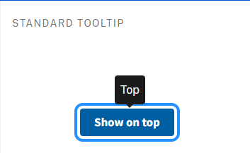
Contextual help
Contextual help isn’t strictly a content issue – it involves interaction and visual design work, as well – but providing contextual help to users when they need it compounds the benefits of plain language.
What is contextual help? It’s offering assistance or extra guidance to users in the moment they need it. Tooltips (hover text), help text, and inline suggestions are all examples of contextual help.

Slide 33
Contextual help
Why is contextual help important in the context of UI applications and other materials?
It allows users to learn more about a word or concept without having to navigate to another page (especially helpful while someone is completing a form).
The UI space is known for having lots of complex terminology and concepts, which would benefit from plain-language definition.
Claimants (target users) may be in an emotionally compromised state & therefore more likely to benefit from contextual help.

Slide 34
Discussion
Plain language includes several tactics, including addressing the user, using active voice, being concise, using inclusive language, and using contextual help.
Which of these approaches is your team already using?
Which might you introduce?
Which might have the biggest impact on your audience?

Slide 35
VALIDATING YOUR WORK

Slide 36
Tips for validating your work
Get leadership buy in: Getting management’s support for ongoing UX research will establish the importance of research across your agency and can help you secure the resources necessary to conduct ongoing research.
Establish clear research goals: The methodology (or methodologies) you choose will be directly related to what you’re trying to learn.
Plan research throughout the content life cycle: Many of us think of testing published content, but you can do research throughout the content life cycle.
Be open to iteration: Doing research is only one step toward creating (or maintaining) useful, usable content – use research findings to inform content updates.
Find more information at plainlanguage.gov and at 18F Methods.

Slide 37
How to use this deck moving forward
We hope you’ve enjoyed and gained valuable information from this workshop (and if you have any questions, we’ll have a Q&A momentarily – you can also follow up afterward.)
Here are some ways you can use this deck in the future:
Share it with colleagues who are interested in learning more about plain language.
Use it as a jumping-off point for a more comprehensive course of self-directed study (the resources section might be especially useful here).
Share it with your leadership team to highlight the benefits of using plain language, which can help with future resourcing.
Use it as you’re writing or editing content to keep plain-language tactics top of mind.

Slide 38
Additional resources

Slide 39
To learn more about plain language, check out the following resources:
Plainlanguage.gov: a great holistic resource for all things plain language
18F Content Guide: an open-source style guide your agency can use or build upon as you build out your content program
Who are you designing for?: help with defining your target audience
User stories…: an Interaction Design Foundation piece on user stories and their benefits, and offering a straightforward user-story template
The Conscious Style Guide: a robust resource on writing more inclusively

Slide 40
To learn more about plain language, check out the following resources:
18F Methods: beginner-friendly human-centered design tools and research methodologies
Writing for the web (usability.gov)
US Web Design System: a design system for the federal government (and a great place to learn about various types of contextual help)
Hemingway Editor and Readability Formulas: tools for checking your content's reading grade level

